Slide 1
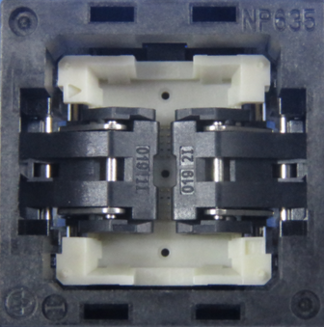
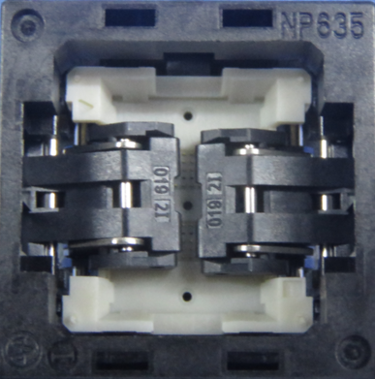

OQC FINDINGS
Date Encountered: Sept. 2, 2024 Sample Size: 80 pcs
Series Name: NP635-153-153-119-AG Contributor: Magallon C.
Defect: Misalign #LT Line: BGA-FP/ LINE 4
Lot Qty.: 637 pcs Lot: 35
GOOD CONDITION : WITHOUT MISALIGN #LT
ACTUAL PRODUCT : WITH MISALIGN #LT

